Slide 1


Slide 2



Slide 3


Quizzes
No Quizzes

Slide 4

Quizzes
Quiz 1
Quiz 4
Quiz 2
Quiz 5
Quiz 3
Quiz 6

Slide 5

Quizzes
No Quizzes
Final Exam
Dependent Variable (Learning)

Slide 6
Quizzes
No Quizzes
Final Exam
Dependent Variable (Learning)
>

Slide 7
Independent Variable:
Quiz or No Quiz
Quizzes
No Quizzes
Dependent Variable:
Final Exam
(Learning Measurement)

Slide 8
Quizzes
No Quizzes
Independent Variable

Slide 9
Quizzes
Final Exam
(Learning Measurement)
No Quizzes

Slide 10
Hypothesis: Taking quizzes leads to better learning in the classroom
Quizzes
IV
No Quizzes
DV

Slide 11
IV
Quizzes
No Quizzes
DV
Hypothesis: Taking quizzes leads to better learning in the classroom

Slide 12
IV
Quizzes
No Quizzes
DV
Hypothesis: Taking quizzes leads to better learning in the classroom

Slide 13
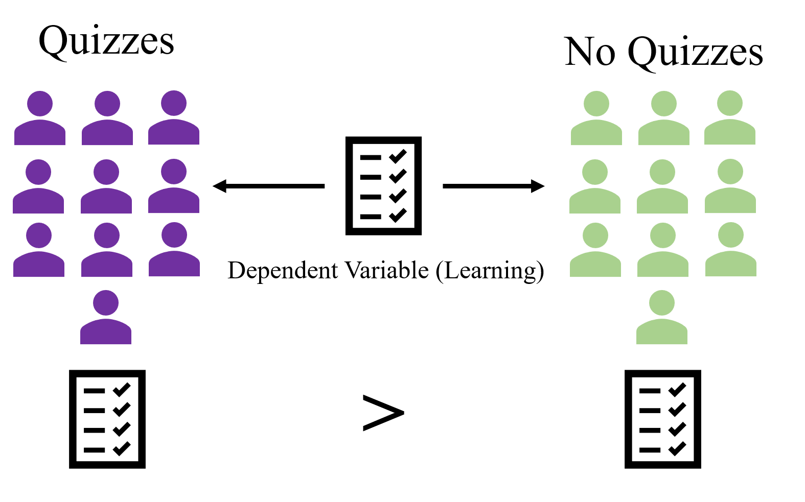

Slide 14
Hypothesis:
A prediction regarding the outcome
of a study

Slide 15
Hypotheses & Theories

Slide 16
Hypotheses & Theories

Slide 17
Hypothesis:
A prediction regarding the outcome of a study

Slide 18








Slide 21
Theory:
Organized system of assumptions that try to explain some phenomenon

Slide 22
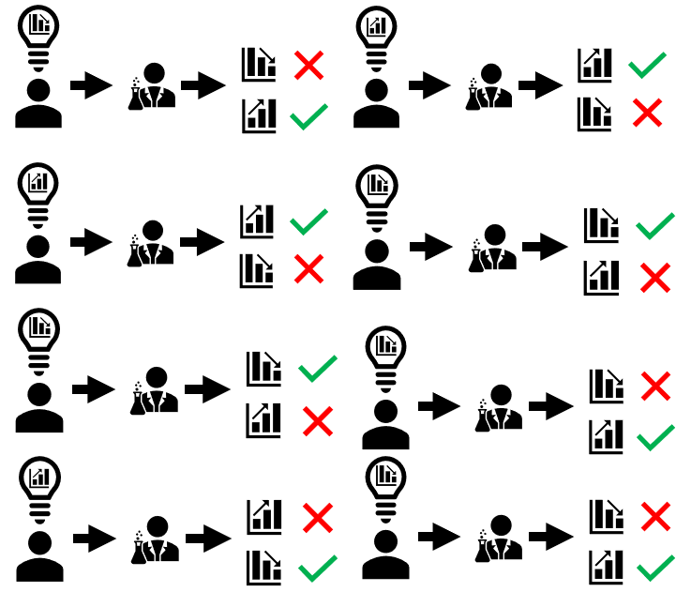
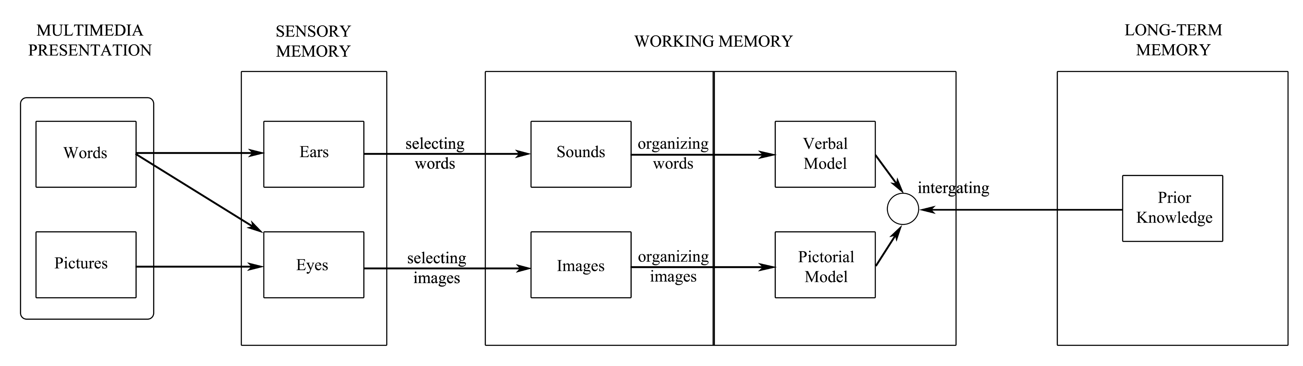
Theory:
Organized system of assumptions that try to explain some phenomenon

Slide 23
Theory:
Organized system of assumptions that try to explain some phenomenon

Slide 24
Pseudoscience:
Claims that appear scientific but violate some important criteria for science

Slide 25
Dependent Variables:
Reliable
Accurate
Precise

Slide 26
Precise:
A measurement that uses units that are small enough for what you are studying.

Slide 27
Accuracy:
Measurement that gives the true value of something.

Slide 28
Reliability:
Consistency with which the DV measures what it is supposed to.

Slide 29


15 lbs
30

Slide 31



Slide 32
65
74
70
70

Slide 33
Dependent Variables:
Must be able to measure real differences that exist between groups

Slide 34
Dependent Variables:
Must be able to measure real differences that exist between groups
Reliable - Provides consistent measurements

Slide 35
Dependent Variables:
Must be able to measure real differences that exist between groups
Reliable - Provides consistent measurements
Accurate - Close as possible to “true value”

Slide 36
Dependent Variables:
Must be able to measure real differences that exist between groups
Reliable - Provides consistent measurements
Accurate - Close as possible to “true value”
Precise - Use small enough units

Slide 37
Constructive Validity
Construct: attribute or ability such as
Aggression
Smart
Friendly
good math skills

Slide 38
Constructive Validity

Slide 39
Predictive Validity

Slide 40
Constructive Validity:
the extent to which researchers are measuring a construct that they claim to be measuring.

Slide 41



# Friends
Friendliness:
Or…

Slide 42
# Friends
Making friends
Friendliness:
Or…

Slide 43
Chemistry Class
Dependent Variable
Final Test on History

Slide 44
Chemistry Class
Dependent Variable
Final Test on History
Poor Construct Validity

Slide 45
Predictive Validity

Slide 46
Good predictive validity – can predict some future performance

Slide 47
3 Types of Validity:
1. Construct - validity
Face validity
Predictive validi

Slide 48
Measures with good face validity contain aspects that look like what is being measured

Slide 49

Predictive Validity
1st Yr.
2nd Yr.
ACT Score
SAT Score
3.0 GPA
4.0 GPA
3rd Yr.
4th Yr.
2.4 GPA
2.6 GPA

Slide 50
ACT Score
SAT Score
1st Yr.
2nd Yr.
3rd Yr.
4th Yr.
4.0 GPA
3.0 GPA
2.0 GPA
2.1 GPA
ACT & SAT More Predictive
ACT & SAT Less Predictive

Slide 51
Face Validity

Slide 53

Good Face Validity & Good Predictive Validity
Test on Mechanics
Mechanical Ability

Slide 54
Poor Face Validity & Good Predictive Validity
Test on Geometry
Mechanical Ability

Slide 55
Validity:
Construct – Measure what you’re interested in

Slide 56
Validity:
Construct – Measure what you’re interested in
Predictive – Accurately predicts outcome variable

Slide 57
Validity:
Construct – Measure what you’re interested in
Predictive – Accurately predicts outcome variable
Face Validity – Looks like it’s measure what it’s supposed to

Slide 58
Validity:
Dependent measures need to be able to support valid conclusions

Slide 59
Objective Measuring
2 + 2 = 4
2 + 2 = 5

Slide 60
Student 1 Argument A 4/10
Student 2 Argument B 10/10
Experimenter 1
Student 1 Argument A 9/10
Student 2 Argument B 3/10
Experimenter 2

Slide 61
Objective Measuring
American Lit Grading Rubric
Logically connects ideas
Makes references to relevant writings
Correct grammar
….
….
….
Student 1 Argument A
9/10
Student 2 Argument B
10/10
Experimenter 1
Student 1 Argument A
9/10
Student 2 Argument B
10/10
Experimenter 2

Slide 62
Experimenter Bias

Slide 63
Experimenter
Survey:
Opinions of Politicians Green & Purple

Slide 64
Survey:
Describe how you feel about Politician Purple?
Describe how you feel about Politician Green?

Slide 65
Political Opinion Survey Data
Participant # | Positive Towards Green | Negative Towards Green | Positive Towards Purple | Negative Towards Purple
Participant 1 | 1 | 0 | 3 | 10
Participant 2 | 0 | 10 | 10 | 0
Participant 3 | 0 | 9 | 8 | 0

Slide 66
Political Opinion Survey Data
Participant # | Positive Towards Green | Negative Towards Green | Positive Towards Purple | Negative Towards Purple
Participant 1 | 1 | 0 | 3 | 10
Participant 2 | 0 | 10 | 10 | 0
Participant 3 | 0 | 9 | 8 | 0

Slide 68
“Skipping sleep one night causes students to get bad grades”

Slide 69
“Skipping sleep one night causes students to get bad grades”
What’s wrong with this conclusion?

Slide 70
Correlation does not equal causation

Slide 71
Experimenter Bias

Slide 72
Experimenter Bias
The ways an experimenter can unknowingly alter the response from any participant in a study.

Slide 73

Cheerium
Sugar Pill (Placebo)

Slide 74

Cheerium
Sugar Pill (Placebo)

Slide 75

Cheerium
Sugar Pill (Placebo)

Slide 76
1
1
1
1
1
1
1
1
1
1
1
1
1
1
1
1
1
1
1
1
1
1
1
1
1
1
A
A
A
A
A
A
A
A
A
A
A
A
A
A
A
A
A
A
A
A
A
A
A
A
A
A
Study Administrator
Experimenter

Slide 77
Subject Bias

Slide 78


Slide 79
Quiz Group
No Quiz Group

Slide 80
Subject Bias: Self-Selection
Quiz Group
No Quiz Group

Slide 81
Quiz Group
No Quiz Group

Slide 82
Subject Bias: Self-Selection
Quiz Group
No Quiz Group

Slide 83
Butterflies Are Not Free
JACKSONVILLE -- Butterflies are beautiful creatures who some believe personify the soul. In Chinese mythology, two butterflies flying together represent love. In Japan, a swarm of them signify a bad omen.
In the United States, they represent big bucks. Wedding planners are buying butterflies by the thousands so that newly married couples can witness thousands filling the sky as they say their vows. Wealthy home owners buy them to fill their gardens. Butterflies are becoming an industry to themselves.
But, there is a problem. That is, although butterflies grow on trees, many desirable species are in low supply. Here enters Jim Cowan, a high school biology teacher in Florida. Mr. Cowan used his biology class to test whether planting several sweet pepperbrush shrubs in a 20 mile area near his school would attract butterflies and keep them in the area. “These shrubs were going to be planted by the park district anyway so I thought I would test whether they would increase the butterfly population in the area,” explained Cowan. “If they did, then the kids would be happy knowing that they would have butterflies in their near future and even at their weddings.”
At the beginning of the semester (1 month before the shrubs were planted) his class placed insect friendly traps throughout the area. Food and water were placed inside of the traps to keep the insects alive. Students working in teams recorded the number of trapped butterflies at weekly intervals. They were careful not to touch the butterflies or mark them in any way so they would not disturb them. Weekly recordings continued after a whopping 10,000 shrubs were planted in the park, and they ended at the completion of the semester, about 2 months later.
“However, something occurred in the middle of the semester that did not ensure butterflies in the students’ future other than in their stomachs. We experienced a devastating drought coupled with high temperatures. It only lasted a week, but it adversely affected the health of the plants in the areas. Many of the pepperbrush shrubs died,” Cowan lamented.
Fortunately, the study did not die out like the shrubs. “It appears that the butterflies in fact must have been attracted to the shrubs because when the shrubs died out, so did the butterfly population. There was a huge statistically significant drop in the number of butterflies before and after the drought,” revealed Cowan.
Cowan is so excited about his discovery that pepperbrush shrubs attract butterflies that he plans to raise butterflies at his uncle’s farm and sell them to nearby wedding planners.

Slide 84
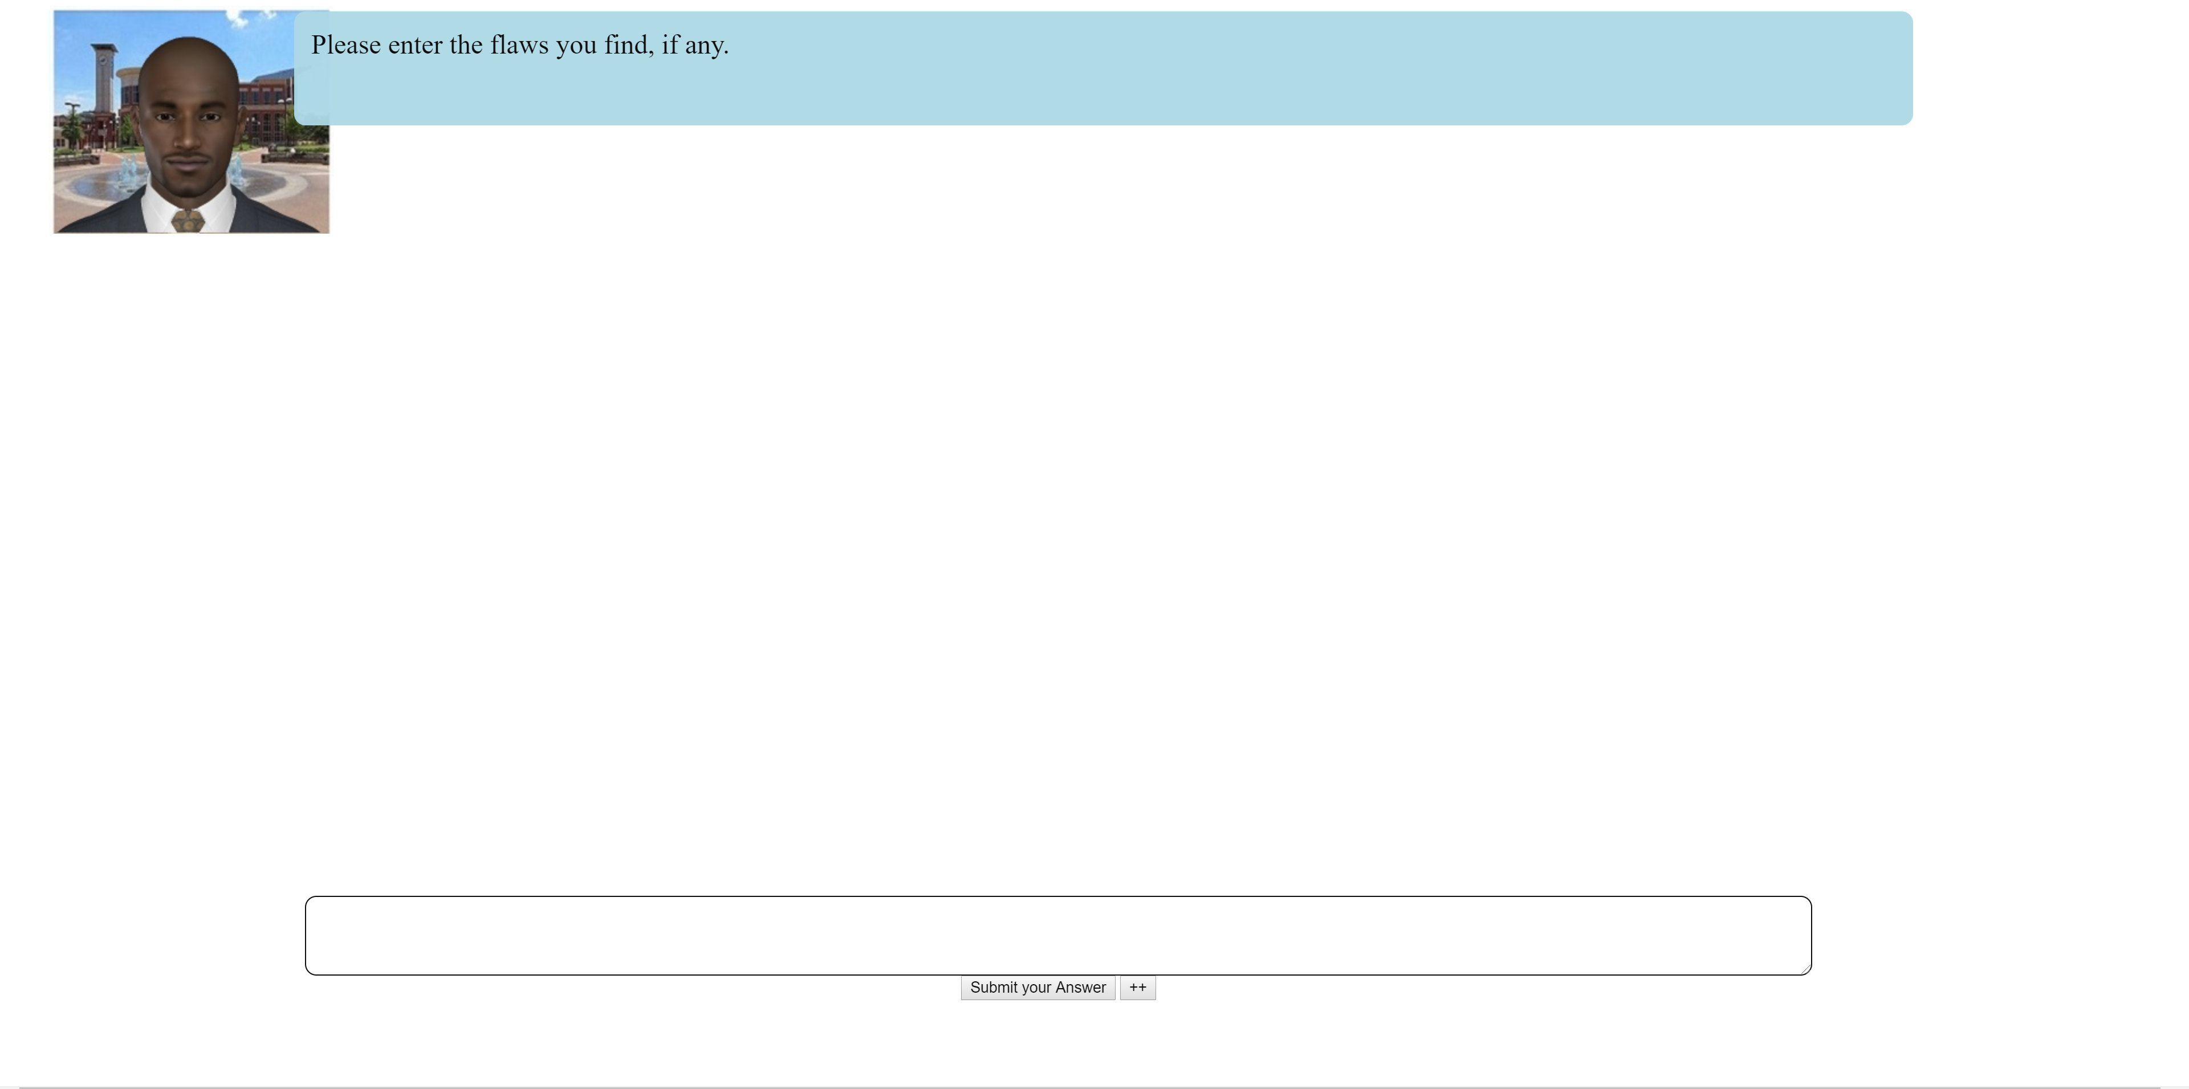
Heavy Metal Music: A Teenager’s Perspective
Like a lot of other kids my age, I like to listen to heavy metal music. Like a lot of other parents, mine complain about the type of music I listen to all the time. They think that my listening to heavy metal music is going to make me sad and depressed. I always tell them they’re wrong-my friends and I all listen to heavy metal music, and we are some of the happiest people I know!
I knew that the only way to get them to back off was to prove to them that they were wrong, so I did some research. I found the one and only article that seems to be out there about the effects of heavy metal music on mood.
In this study, 80 participants were randomly put into one of two groups. In one group, the participants were told that they could not listen to heavy metal music for one whole month. In the other group, the participants had to listen to heavy metal music for two hours every day for a month.
After the month was over, everyone had to fill out a survey with a lot of different rating questions. There were so many different questions that no one who participated could have guessed that depression was being studied.
The main question that the researchers were interested in was how the participants rated their anxiety/emotional level. So the key question was “What is your current emotional state,” and the participants answered by circling either “anxious” or “not anxious.” The researchers were unaware of which condition the participants were in when they did the final data analyses.
The researchers found that 60% of the participants who listened to heavy metal music reported feeling anxious, as did 58% of the participants who did not listen to the music at all. This was not a statistically significant difference.
So, what does all this mean for me? Well, it means that even though my parents admitted to me that I was right-I’m not going to become depressed from listening to heavy metal music-they still don’t want me to listen to it. But, the take-home message for all the other teens and their parents out there is this: Listening to heavy metal music is not going to lead to depression, so listen to it as much as you like!

Slide 85
Heavy Metal Music: A Teenager’s Perspective
Like a lot of other kids my age, I like to listen to heavy metal music. Like a lot of other parents, mine complain about the type of music I listen to all the time. They think that my listening to heavy metal music is going to make me sad and depressed. I always tell them they’re wrong-my friends and I all listen to heavy metal music, and we are some of the happiest people I know! I knew that the only way to get them to back off was to prove to them that they were wrong, so I did some research. I found the one and only article that seems to be out there about the effects of heavy metal music on mood.
In this study, 80 participants were randomly put into one of two groups. In one group, the participants were told that they could not listen to heavy metal music for one whole month. In the other group, the participants had to listen to heavy metal music for two hours every day for a month. After the month was over, everyone had to fill out a survey with a lot of different rating questions. There were so many different questions that no one who participated could have guessed that depression was being studied.
The main question that the researchers were interested in was how the participants rated their anxiety/emotional level. So the key question was “What is your current emotional state,” and the participants answered by circling either “anxious” or “not anxious.” The researchers were unaware of which condition the participants were in when they did the final data analyses. The researchers found that 60% of the participants who listened to heavy metal music reported feeling anxious, as did 58% of the participants who did not listen to the music at all. This was not a statistically significant difference.
So, what does all this mean for me? Well, it means that even though my parents admitted to me that I was right-I’m not going to become depressed from listening to heavy metal music-they still don’t want me to listen to it. But, the take-home message for all the other teens and their parents out there is this: Listening to heavy metal music is not going to lead to depression, so listen to it as much as you like!

Slide 86
Butterflies Are Not Free
JACKSONVILLE -- Butterflies are beautiful creatures who some believe personify the soul. In Chinese mythology, two butterflies flying together represent love. In Japan, a swarm of them signify a bad omen.
In the United States, they represent big bucks. Wedding planners are buying butterflies by the thousands so that newly married couples can witness thousands filling the sky as they say their vows. Wealthy home owners buy them to fill their gardens. Butterflies are becoming an industry to themselves.
But, there is a problem. That is, although butterflies grow on trees, many desirable species are in low supply. Here enters Jim Cowan, a high school biology teacher in Florida. Mr. Cowan used his biology class to test whether planting several sweet pepperbrush shrubs in a 20 mile area near his school would attract butterflies and keep them in the area.
“These shrubs were going to be planted by the park district anyway so I thought I would test whether they would increase the butterfly population in the area,” explained Cowan. “If they did, then the kids would be happy knowing that they would have butterflies in their near future and even at their weddings.”
At the beginning of the semester (1 month before the shrubs were planted) his class placed insect friendly traps throughout the area. Food and water were placed inside of the traps to keep the insects alive. Students working in teams recorded the number of trapped butterflies at weekly intervals. They were careful not to touch the butterflies or mark them in any way so they would not disturb them. Weekly recordings continued after a whopping 10,000 shrubs were planted in the park, and they ended at the completion of the semester, about 2 months later.
“However, something occurred in the middle of the semester that did not ensure butterflies in the students’ future other than in their stomachs. We experienced a devastating drought coupled with high temperatures. It only lasted a week, but it adversely affected the health of the plants in the areas. Many of the pepperbrush shrubs died,” Cowan lamented.
Fortunately, the study did not die out like the shrubs. “It appears that the butterflies in fact must have been attracted to the shrubs because when the shrubs died out, so did the butterfly population. There was a huge statistically significant drop in the number of butterflies before and after the drought,” revealed Cowan.
Cowan is so excited about his discovery that pepperbrush shrubs attract butterflies that he plans to raise butterflies at his uncle’s farm and sell them to nearby wedding planners.

Slide 87
Theory:
Organized system of assumptions that try to explain some phenomenon

Slide 88
Theory:
Organized system of assumptions that try to explain some phenomenon

Slide 89
Hypnosis and Pain (Type the letter)
A. Can hypnosis relieve pain?
B. Hypnosis can relieve pain by distracting people from the perception of pain, so they are not aware of it.
C. Hypnosis can help you quit smoking because it really works.

Slide 90
Reliable and Accurate (Type the letter)
A. An accurate measure was carefully recorded and carefully controlled; a reliable measure is consistent and will be approximately the same each time if nothing has happened that might change it (like weighing less a week after you go on a diet).
B. Every measure that is accurate will also be reliable.
C. Both are concerned with being careful during measurement, but accuracy is about units of measurement and reliability is about how much effect the independent variable had on the dependent variable.

Slide 91
Hypnosis and Pain (Type the letter)
A. Can hypnosis relieve pain?
B. Hypnosis can relieve pain by distracting people from the perception of pain, so they are not aware of it.
C. Hypnosis can help you quit smoking because it really works.

Slide 92
Subject Bias
Experimenters should not provide cues
Should also randomly assign participants into conditions

Slide 93
Subject Bias
Experimenters should not provide cues
Should also randomly assign participants into conditions

Slide 94
Subject Bias

Slide 95
Sample Selection

Slide 96

Sample Selection

Slide 97
Sample Selection
6 ft or Taller
5 ft 4 inches or shorter

Slide 98
Sample Selection
6 ft ≤
5.4 ft ≥

Slide 99
Sample Selection

Slide 100


Slide 101


Slide 102



Slide 104
With random sampling everyone has an equal chance of being in a sample

Slide 105
If sample characteristics are different from the population, the differences can account for the results instead of the independent variable

Slide 106
Sample Size

Slide 107
Sample Size
Population’s variability plays a critical role in determining the extent that the sample average will match the population average

Slide 108
Sample Size
How many are needed?

Slide 109
Sample Size
How many are needed?
20 - 25, per condition (general rule)

Slide 110
Sample Size
How many are needed?

Slide 111


Slide 112


Slide 115
Sample Size
Population's variability plays a critical role in determining the extent that the sample average will match the population average

Slide 116
Research Design & Methods Flaws
Experimenter Bias
Subject Bias
Poor Sample Selection
Small Sample Size

Slide 117
Generalizability
How much our results generalize to the “real world”

Slide 118
Replication
Multiple studies that show a similar trend or have the same results

Slide 120


